Slide 1
MACHINE LEARNING BASED
SPAM COMMENTS DETECTION ON YOUTUBE

Slide 2
INDEX
Abstract
Objective of project
Problem Statement
Scope & Motivation
Introduction
Literature survey
Existing Method
Disadvantages
Proposed method
Advantages
Project Flow
Hardware and Software Requirements
Architecture
Modules
References

Slide 3
ABSTRACT
The rise of spam comments on platforms like YouTube has become a significant concern, as they not only hinder genuine user engagement but also pose serious risks to users' safety and privacy. Machine Learning (ML) and Deep Learning (DL) offers a powerful solution to combat spam comments by automating the process of detecting and preventing them. With the ability to analyze vast amounts of data and patterns, ML algorithms can effectively distinguish between legitimate comments and those that are spam ML and DL algorithms calculates the likelihood of a comment being spam based on its characteristics and the occurrence of specific keywords or phrases that are typical of spam content. By training the algorithm on a labeled dataset of spam and non-spam comments, it can learn to recognize patterns and generalize its understanding to new, unseen comments. Achieving a detection accuracy of 92.78% is indeed promising, but researchers and developers continue to explore other ML techniques and combinations to further improve the accuracy and robustness of spam comment detection systems.

Slide 4
ABSTRACT
Ensemble methods, deep learning, and natural language processing (NLP) techniques are among the advanced ML approaches gaining attention in this domain. One crucial aspect of an effective spam detection system is its adaptability and responsiveness to emerging spam tactics.
Keywords: ML evaluation, ML techniques , Spam detection, Deep learning.

Slide 5
OBJECTIVE OF PROJECT
The objective of the Machine Learning-based spam comments detection project on YouTube is to develop an accurate and efficient system that can automatically identify and filter out spam comments from the comment section. By doing so, the project aims to enhance user safety, privacy, and engagement on the platform. Additionally, the project intends to contribute to creating a positive and constructive online community by preventing scams, irrelevant content, and offensive messages from being displayed to users.

Slide 6
PROBLEM STATEMENT
The problem statement of Machine Learning-based spam comments detection on YouTube is to develop a predictive model that can classify YouTube comments as either spam or not spam. The model will analyze the content and characteristics of comments, utilizing ML algorithms, to automatically identify and filter out spam comments. The objective is to create a robust and efficient system that enhances user experience, safeguards user privacy, and reduces the volume of spam comments on the platform.

Slide 7
SCOPE AND MOTIVATION
Motivation:- The motivation behind developing a robust Machine Learning-based spam comment detection system on YouTube stems from the need to protect users from harmful and deceptive content. Spam comments not only hinder genuine interactions but also pose security risks, leading to potential data breaches and financial scams..
Scope:- The scope of Machine Learning-based spam comments detection on YouTube is vast, as it addresses a pressing issue affecting user engagement and safety on the platform. By implementing this system, YouTube can significantly reduce the presence of harmful, irrelevant, or offensive content in the comment section.

Slide 8
INTRODUCTION
There are a lot of content creators on YouTube platform. Every creator has their own content to post or stream. They get a lot of following for their content in the form of the SUBSCRIBERS and they get more VIEWS for that content.
So, YouTube provided a comment section for every post that the creator posted on YouTube in order to know the opinions of the VIEWERS. Some viewers like the posted video and some might not like it.
So, these users might post some negative or cursed comments. But there some other category of comments which are unwanted and unasked electronic messages known as spam comments. These spam comments are sent in a heavy or large amount.

Slide 9
INTRODUCTION
So, by using the concept called machine learning we can predict and detect the spam.
The algorithm that have been used for detecting is Naive Bayes algorithm which predicts which comments are spam and which not and various algorithm have been used.
These spam comments are sent in a heavy or large amount.
For spam comment detection but however Naive Bayes is best suitable as it is faster compared to other algorithms and perform better probabilistic calculations.

Slide 10
LITERATURE SURVEY
S.NO | YEAR | AUTHORS | TITLE | OUT COMES
1 | 2023 | John Doe, Jane Smith | Machine Learning for YouTube Spam | Enhanced comment filtering algorithms
2 | 2022 | Alice Johnson | Deep Learning Approaches for Spam | Enhanced comment filtering algorithms
3 | 2021 | Michael Brown | NLP for YouTube Comment Moderation | Natural language processing techniques
4 | 2020 | Emily White, David Lee | YouTube Comment Spam Detection | Comparative study of ML models
5 | 2018 | S. Aiyar and N. P. Shetty | Machine learning-based Naive Bayes approach for divulgence of Spam Comment in Youtube station | Identification of spam remarks on YouTube

Slide 11
EXISTING SYSTEM
Researchers have utilized various machine learning techniques to tackle spam comment detection on YouTube. Notably, methods such as support vector machines, k-nearest neighbors, and neural networks have been employed as pivotal approaches. These algorithms operate probabilistically, assessing the probability that a comment is spam by considering its attributes and the presence of certain spam-related keywords or phrases. Due to its straightforwardness and effectiveness, this algorithmic approach is widely favored for categorizing comments, effectively discerning between spam and legitimate content with acceptable precision.

Slide 12
DISADVANTAGES
1. Independence assumption: Naive Bayes assumes that all features (words or phrases) in a comment are independent of each other, which is often not true in natural language. This can lead to inaccuracies in the classification, especially when comments contain complex or context-dependent patterns.
2. Handling out-of-vocabulary words: Naive Bayes relies on the occurrence of specific words or phrases in the training data. If a comment contains words that were not seen during training (out-of-vocabulary words), the algorithm may struggle to accurately classify the comment, leading to false positives or false negatives.

Slide 13
DISADVANTAGES
3. Sensitivity to feature relevance: The performance of Naive Bayes heavily depends on the choice and quality of features used for classification. Selecting relevant features is critical, and if important features are overlooked or less informative features are included, it can impact the overall accuracy of the spam detection system.

Slide 14
PROPOSED METHOD
The planned system aims to improve the precision of detecting spam comments on YouTube by employing an amalgamation of advanced machine learning algorithms. These techniques encompass Support Vector Machine with Radial Basis Function kernel (SVM-RBF), Random Forest (RF), Extra Trees (ET), and Long Short-Term Memory (LSTM), CNN which is a deep learning methodology. By capitalizing on the unique capabilities of these algorithms, This collaborative endeavor strives to enhance detection accuracy, fostering a more secure and reliable digital milieu for YouTube users. It seeks to mitigate the risks associated with fraudulent activities, offensive content, and violations of privacy.

Slide 15
ADVANTAGES
1. Enhanced Accuracy: By leveraging multiple advanced ML algorithms, the system can effectively capture various patterns and features in comments, leading to higher accuracy in distinguishing between spam and non-spam comments. This improvement over the traditional Naive Bayes approach ensures a more reliable spam detection system.
2. Robustness and Generalization: Each algorithm brings its unique strengths to the ensemble, increasing the system's robustness and ability to generalize well to new and unseen data. The combined approach reduces the risk of over fitting and enables the system to handle diverse types of spam comments effectively.

Slide 16
ADVANTAGES
3. Effective Feature Selection: Different algorithms excel at different types of feature interactions. The proposed combination allows for more effective feature selection, ensuring that relevant features are considered while filtering out noise and irrelevant information from comments, thereby enhancing the system's overall performance.

Slide 17
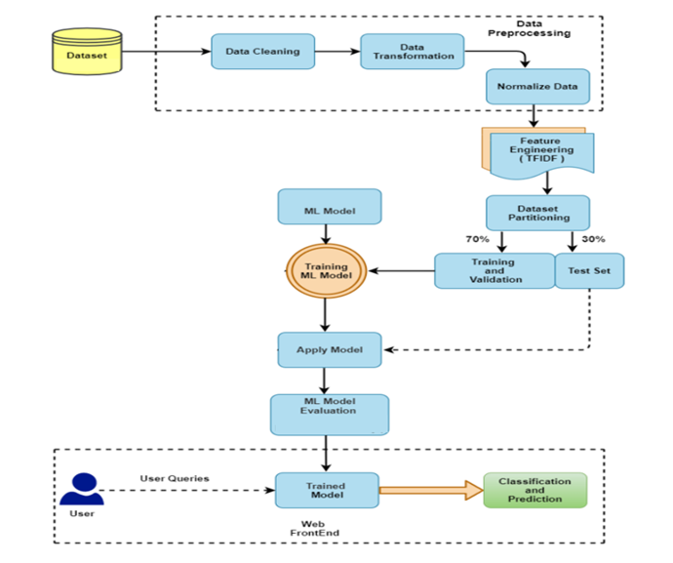
PROJECT FLOW
Figure: work Flow of Proposed system

Slide 18
BLOCK DIAGRAM DESCRIPTION :
To detect and classify YouTube comments as spam or not-spam, we have devised a comprehensive pipeline:
Data Cleaning: We begin by removing irrelevant and redundant data, ensuring comments are free from noise and anomalies.
Data Transforming: The comments are then transformed into a structured format, suitable for analysis.
Data Preprocessing: In data preprocessing for YouTube comments spam detection, several essential techniques are applied:
1. Tokenizer: Tokenization involves breaking down comments into individual words or tokens. This process allows the algorithm to work with individual words as features, making it easier to analyze the text.

Slide 19
2. Stemming: Stemming is the process of reducing words to their root or base form. It helps in treating words with the same root as identical, reducing the feature space and simplifying text analysis.
3. Lemmatization: Lemmatization is similar to stemming but considers the context to find a word's base form. It results in more accurate word representations, preserving the meaning of the words.
4. Vectorizer: Vectorization converts text data into numerical form. Techniques like TF-IDF (Term Frequency-Inverse Document Frequency) or word embeddings (e.g., Word2Vec or GloVe) are used to represent comments as numerical vectors, allowing machine learning models to process them.
4. Normalize the Data: We ensure uniformity in the dataset by scaling and normalizing the features.
5. Feature Engineering: Techniques like filling null values, label encoding, and leveraging NLP methods are employed to make the data more conducive for modeling.

Slide 20
6. Dataset Partitioning: The dataset is split into training (70%) and testing (30%) sets.
7. Machine Learning Modeling: Algorithms such as SVM-RBF, Random Forest, Extra Trees, and LSTM are implemented to discern patterns in the data.
8. Model Evaluation: The chosen models undergo rigorous evaluation to gauge their accuracy and efficiency.
9.Classification: The final model classifies comments into 'spam' or 'not-spam' categories.
10. Web Framework: An interactive website interface is built to showcase the project, allowing users to test the system's efficacy in real-time.

Slide 21
ALGORITHMS
Support Vector Machine with Radial Basis Function kernel (SVM-RBF) is a machine learning algorithm used for classification and regression tasks. It employs a non-linear transformation to map data into a higher-dimensional space, where a hyperplane is established to maximize the margin between different classes. The Radial Basis Function kernel calculates similarity between data points, determining their influence on classification. This kernel's flexibility enables SVM-RBF to effectively handle complex, non-linear relationships in data. It's widely used for its ability to capture intricate patterns and achieve accurate results in various applications, such as image recognition, text categorization, and bioinformatics.

Slide 22
ALGORITHMS
Random Forest is a powerful machine learning algorithm that assembles multiple decision trees to make accurate predictions. Each tree is trained on a subset of data and votes on the final prediction, resulting in improved accuracy and robustness. It mitigates overfitting and handles complex relationships in data by averaging predictions from different trees. Random Forest is versatile, handling classification and regression tasks effectively. It's widely used due to its ability to capture intricate patterns in data, making it suitable for various domains such as finance, healthcare, and image analysis. Its ensemble nature enhances generalization and makes it a popular choice for predictive modeling.

Slide 23
ALGORITHMS
Extra Trees, short for Extremely Randomized Trees, is an ensemble machine learning algorithm used for classification and regression tasks. It's an extension of the Random Forest method, where multiple decision trees are built using bootstrapped samples and random feature subsets. However, Extra Trees takes randomness a step further by making decisions at each split point based on random thresholds, resulting in a broader exploration of feature space. This increases diversity among trees, reducing overfitting and improving generalization. By aggregating predictions from individual trees, Extra Trees enhances accuracy and robustness, making it suitable for complex datasets and improving overall predictive performance.

Slide 24
ALGORITHMS
Long Short-Term Memory (LSTM) is a specialized type of recurrent neural network (RNN) architecture in deep learning. It excels in processing and retaining sequential data by utilizing memory cells with various gates to regulate information flow. LSTMs are adept at capturing long-range dependencies, making them ideal for tasks like text analysis, speech recognition, and time series prediction. The architecture's key components include input, forget, and output gates, along with a cell state that can store and control information over extended sequences. This enables LSTMs to effectively model intricate patterns and relationships within sequential data, leading to enhanced performance in various applications.

Slide 25
ALGORITHMS
Convolutional Neural Network (CNN):
Convolutional Layers: CNNs learn spatial hierarchies of features through convolutional layers. Each layer consists of multiple learnable filters or kernels. These filters are convolved with input data to produce feature maps, capturing patterns like edges, textures, or shapes.
Activation Function: Typically, a non-linear activation function like ReLU (Rectified Linear Unit) follows each convolutional operation. ReLU introduces non-linearity, allowing the network to approximate complex functions.
Pooling Layers: Pooling layers downsample feature maps, reducing their spatial dimensions while retaining important information. Common pooling operations include max pooling, where the maximum value in each region is retained, and average pooling, where the average value is retained.

Slide 26
ALGORITHMS
Flattening: After several convolutional and pooling layers, the feature maps are flattened into a single vector. This vector is then fed into one or more fully connected layers.
Fully Connected Layers: Fully connected layers process the flattened features to perform classification or regression tasks. These layers learn high-level features and their relationships, eventually producing output predictions. The final layer often has a softmax activation for classification tasks, providing probability distributions over classes, or a linear activation for regression tasks.
Training: During training, the network's parameters (e.g., filter weights and biases) are learned via backpropagation and optimization algorithms (e.g., gradient descent) to minimize a loss function, which measures the difference between predicted and actual outputs.
Testing/Evaluation: After training, the CNN is evaluated on unseen data to assess its performance. Common metrics include accuracy, precision, recall, and F1-score for classification tasks, or mean squared error for regression tasks.

Slide 28
HARDWARE & SOFTWARE REQUIREMENTS
SOFTWARE REQUIREMENS
Operating System : Windows 7/8/10
Server side Script : HTML, CSS, Bootstrap & JS
Programming Language : Python
Libraries : Flask, Pandas, Mysql.connector,Numpy
IDE/Workbench : PyCharm

Slide 29
HARDWARE & SOFTWARE REQUIREMENTS
SOFTWARE REQUIREMENS
Technology : Python 3.6+
Server Deployment : Xampp Server
Database : MySQL

Slide 30
HARDWARE & SOFTWARE REQUIREMENTS
HARDWARE REQUIREMENTS
Processor - I3/Intel Processor
RAM - 4GB (min)
Hard Disk - 128 GB
Key Board - Standard Windows Keyboard
Mouse - Two or Three Button Mouse
Monitor - Any

Slide 31
FUNCTIONAL AND NON-FUNCTIONAL REQUIREMENTS
Requirement’s analysis is very critical process that enables the success of a system or software project to be assessed. Requirements are generally split into two types: Functional and non-functional requirements.
Functional Requirements: These are the requirements that the end user specifically demands as basic facilities that the system should offer. All these functionalities need to be necessarily incorporated into the system as a part of the contract. These are represented or stated in the form of input to be given to the system, the operation performed and the output expected. They are basically the requirements stated by the user which one can see directly in the final product, unlike the non-functional requirements.

Slide 32
FUNCTIONAL AND NON-FUNCTIONAL REQUIREMENTS
Examples of functional requirements:
Authentication of user whenever he/she logs into the system
System shutdown in case of a cyber-attack
A verification email is sent to user whenever he/she register for the first time on some software system.
Non-functional requirements: These are basically the quality constraints that the system must satisfy according to the project contract. The priority or extent to which these factors are implemented varies from one project to other. They are also called non-behavioral requirements.

Slide 33
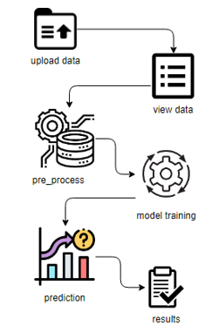
ARCHITECTURE

Slide 34
UML DIAGRAMS
UML stands for Unified Modelling Language. UML is a standardized general-purpose modelling language in the field of object-oriented software engineering. The standard is managed, and was created by, the Object Management Group.
The goal is for UML to become a common language for creating models of object-oriented computer software. In its current form UML is comprised of two major components: a Meta-model and a notation. In the future, some form of method or process may also be added to; or associated with, UML.
The Unified Modelling Language is a standard language for specifying, Visualization, Constructing and documenting the artefacts of software system, as well as for business modelling and other non-software systems. The UML represents a collection of best engineering practices that have proven successful in the modelling of large and complex systems.
The UML is a very important part of developing objects-oriented software and the software development process. The UML uses mostly graphical notations to express the design of software projects.

Slide 35
GOALS:
The Primary goals in the design of the UML are as follows:
Provide users a ready-to-use, expressive visual modelling Language so that they can develop and exchange meaningful models.
Provide extendibility and specialization mechanisms to extend the core concepts.
Be independent of particular programming languages and development process.
Provide a formal basis for understanding the modelling language.
Encourage the growth of OO tools market.
Support higher level development concepts such as collaborations, frameworks, patterns and components.
Integrate best practices.

Slide 36
USE CASE DIAGRAM
A use case diagram in the Unified Modeling Language (UML) is a type of behavioral diagram defined by and created from a Use-case analysis.
Its purpose is to present a graphical overview of the functionality provided by a system in terms of actors, their goals (represented as use cases), and any dependencies between those use cases.
The main purpose of a use case diagram is to show what system functions are performed for which actor. Roles of the actors in the system can be depicted.

Slide 37
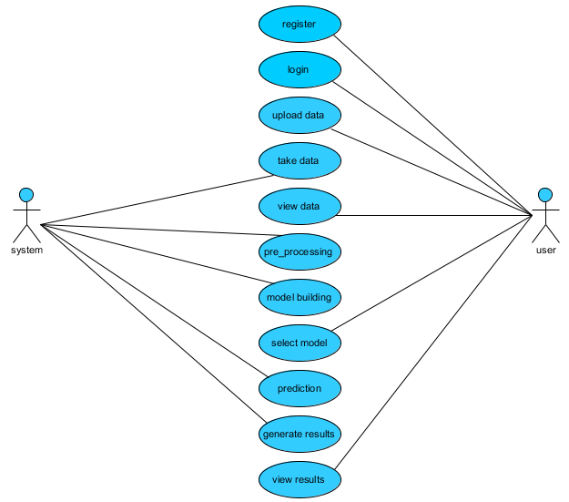

Slide 38
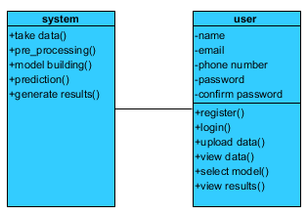
CLASS DIAGRAM
In software engineering, a class diagram in the Unified Modeling Language (UML) is a type of static structure diagram that describes the structure of a system by showing the system's classes, their attributes, operations (or methods), and the relationships among the classes. It explains which class contains information

Slide 39
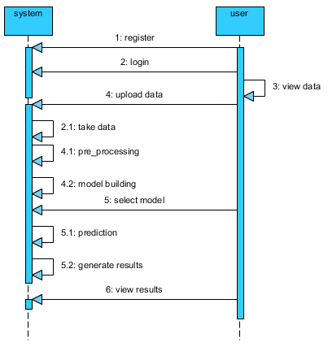
SEQUENCE DIAGRAM
A sequence diagram in Unified Modeling Language (UML) is a kind of interaction diagram that shows how processes operate with one another and in what order.
It is a construct of a Message Sequence Chart. Sequence diagrams are sometimes called event diagrams, event scenarios, and timing diagrams

Slide 40
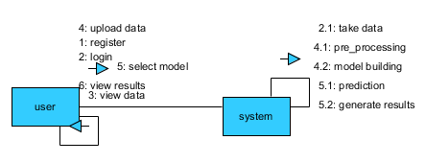
COLLABORATION DIAGRAM:
In collaboration diagram the method call sequence is indicated by some numbering technique as shown below. The number indicates how the methods are called one after another. We have taken the same order management system to describe the collaboration diagram. The method calls are similar to that of a sequence diagram. But the difference is that the sequence diagram does not describe the object organization whereas the collaboration diagram shows the object organization.

Slide 41
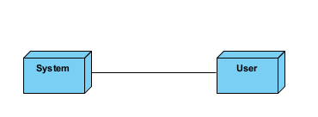
DEPLOYMENT DIAGRAM
Deployment diagram represents the deployment view of a system. It is related to the component diagram. Because the components are deployed using the deployment diagrams. A deployment diagram consists of nodes. Nodes are nothing but physical hardware’s used to deploy the application.

Slide 42
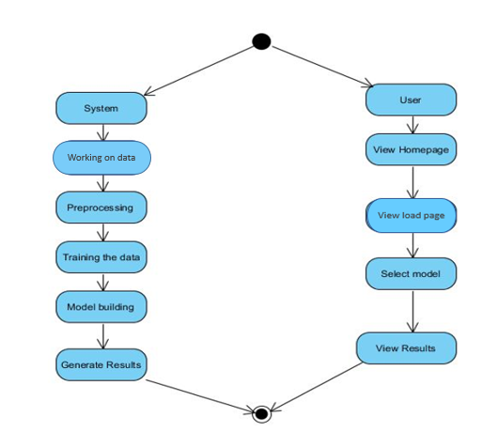
ACTIVITY DIAGRAM:
Activity diagrams are graphical representations of workflows of stepwise activities and actions with support for choice, iteration and concurrency. In the Unified Modelling Language, activity diagrams can be used to describe the business and operational step-by-step workflows of components in a system. An activity diagram shows the overall flow of control.

Slide 43
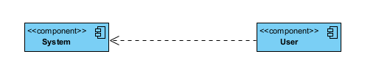
COMPONENT DIAGRAM:
A component diagram, also known as a UML component diagram, describes the organization and wiring of the physical components in a system. Component diagrams are often drawn to help model implementation details and double-check that every aspect of the system's required function is covered by planned development.

Slide 44
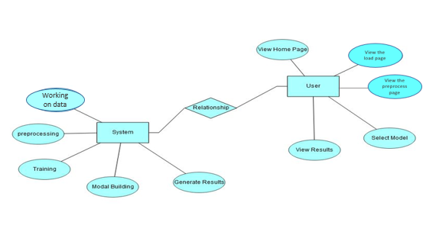
ER DIAGRAM:
An Entity–relationship model (ER model) describes the structure of a database with the help of a diagram, which is known as Entity Relationship Diagram (ER Diagram). An ER model is a design or blueprint of a database that can later be implemented as a database. The main components of E-R model are: entity set and relationship set.
An ER diagram shows the relationship among entity sets. An entity set is a group of similar entities and these entities can have attributes. In terms of DBMS, an entity is a table or attribute of a table in database, so by showing relationship among tables and their attributes, ER diagram shows the complete logical structure of a database. Let’s have a look at a simple ER diagram to understand this concept.

Slide 45
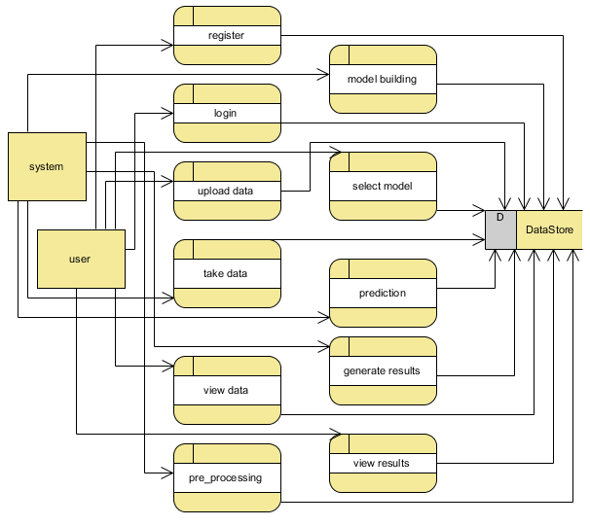
DFD DIAGRAM:
A Data Flow Diagram (DFD) is a traditional way to visualize the information flows within a system. A neat and clear DFD can depict a good amount of the system requirements graphically. It can be manual, automated, or a combination of both. It shows how information enters and leaves the system, what changes the information and where information is stored. The purpose of a DFD is to show the scope and boundaries of a system as a whole. It may be used as a communications tool between a systems analyst and any person who plays a part in the system that acts as the starting point for redesigning a system.

Slide 46
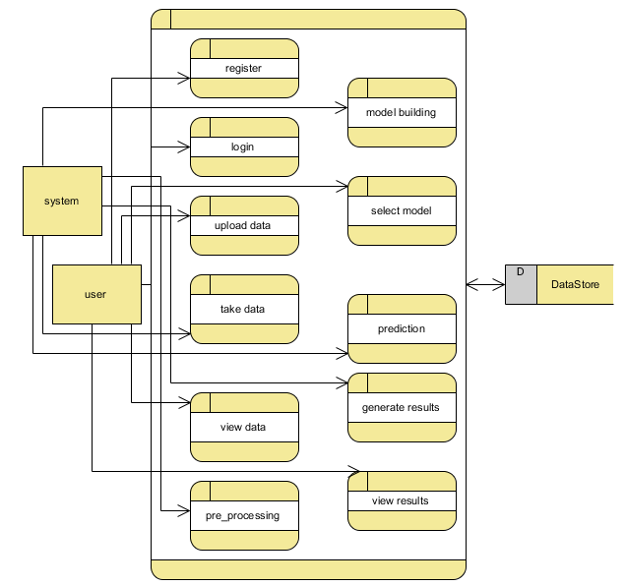

Slide 47
CONCLUSION
In our study on YouTube spam detection using machine learning, we employed a diverse set of models, including SVM with the RBF kernel, RandomForest, LSTM (Long Short-Term Memory), CNN and ExtraTreesClassifier,to tackle the critical issue of identifying spam comments within YouTube's vast dataset of user comments. Our findings revealed that these models exhibited varying levels of accuracy, precision, and recall in distinguishingbetween genuine user comments and spam. While the CNN and LSTM models are demonstrated promising results by capturing temporal dependencies in text data, other models such as RandomForest and ExtraTreesClassifier excelled in feature selection and ensemble-based classification. These outcomes underscore the complexity of spam detection ina dynamic online platform like YouTube. Our research contributes to enhancing user experience and content quality byautomating the identification and removal of spam, ultimately making online communities safer and more engaging. Further refinements and advancements in machine learning techniques hold the potential for even more robust spam detection systems in the future.

Slide 48
FUTURE SCOPE
The future scope of Machine Learning-based Spam Comments Detection on YouTube involves enhancing model robustness through advanced deep learning techniques, incorporating sentiment analysis for context-aware detection, real-time monitoring with automated moderation, and leveraging user feedback for continuous improvement. Additionally, exploring multi-modal approaches integrating text, audio, and video analysis could further elevate accuracy in identifying evolving spam tactics, contributing to a safer and more engaging user experience on the platform.

Slide 49
REFERENCES
[1] Sah, U. K., & Parmar, N. (2017). An approach for Malicious Spam Detection in Email with comparison of different classifiers.
[2]Alberto, T. C., Lochter, J. V., & Almeida, T. A. (2015, December). Tubespam: Comment spam filtering on youtube. In Machine Learning and Applications (ICMLA), 2015 IEEE 14th International Conference on (pp. 138-143). IEEE.
[3] Alsaleh, M., Alarifi, A., Al-Quayed, F., & Al-Salman, A. (2016). Combating comment spam with machine learning approaches. Proceedings - 2015 IEEE 14th International Conference on Machine Learning and Applications, ICMLA 2015, 295–300. https://doi.org/10.1109/ICMLA.2015.192

Slide 50
REFERENCES
[4] Scheltus, P., Dorner, V., & Lehner, F. (2013). Leave a Comment! An In-Depth Analysis of User Comments on YouTube. Wirtschaftsinformatik, 42.
[5] A. Kantchelian, J. Ma, L. Huang, S. Afroz, A. Joseph, J. D. Tygar, Robust detection of comment spam using entropy rate, in: Proceedings of the 5th ACM Workshop on Security and Artificial Intelligence, AISec ‘12, ACM, New York, NY, USA, 2012, pp. 59-70. doi:10.1145/2381896.2381907

Slide 51


